Slide 1


Slide 2
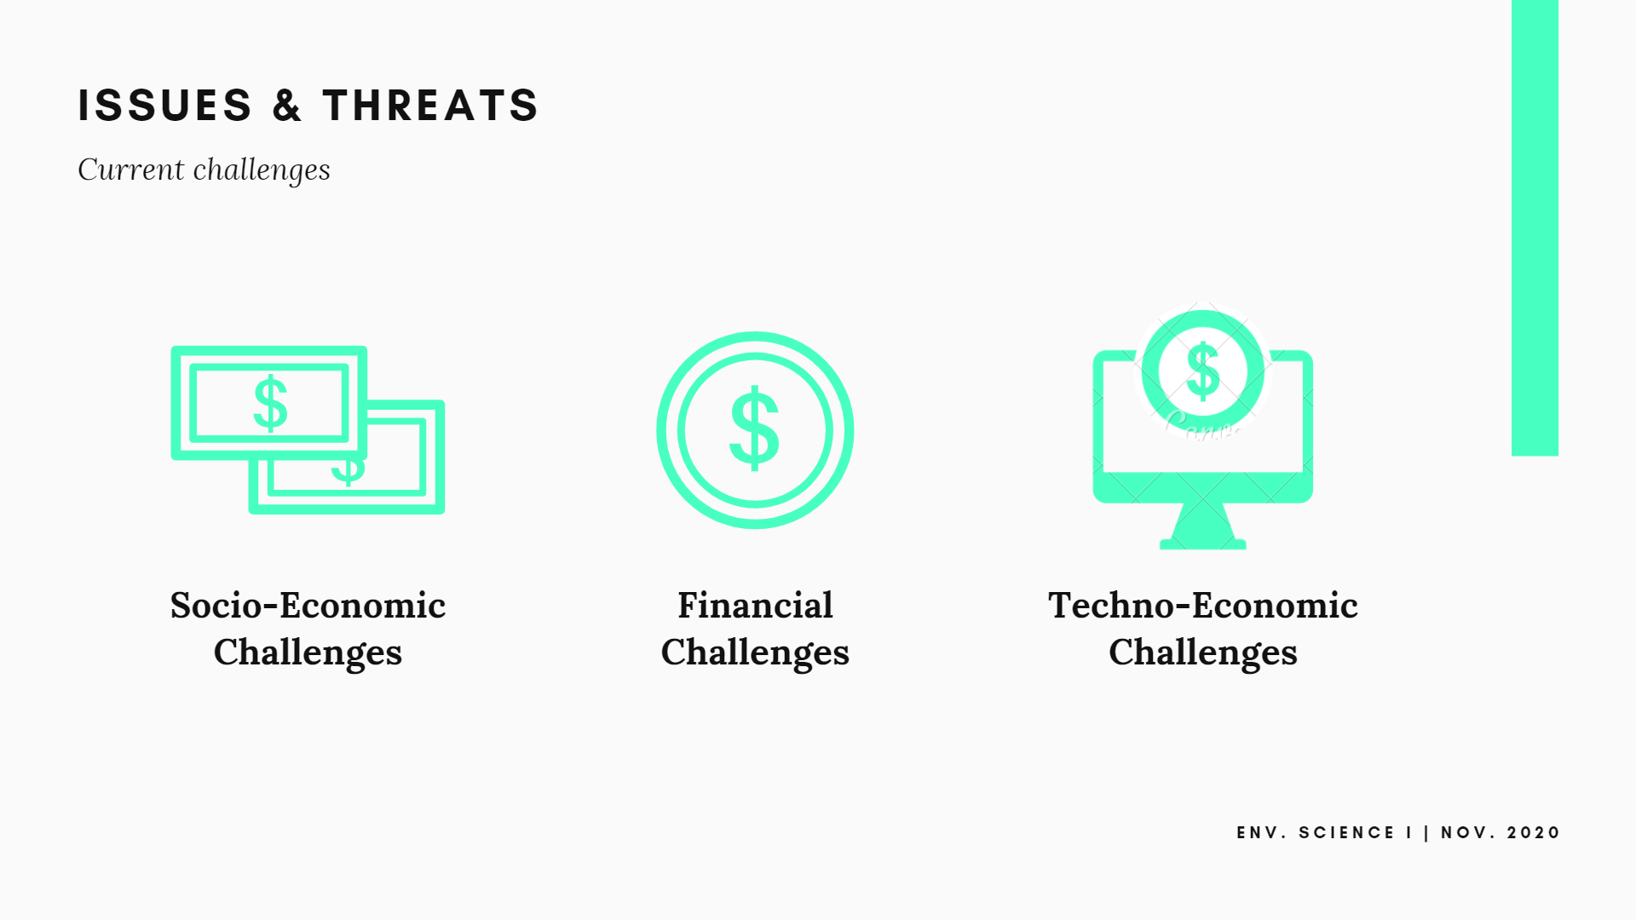

Slide 3


Slide 4


Slide 5
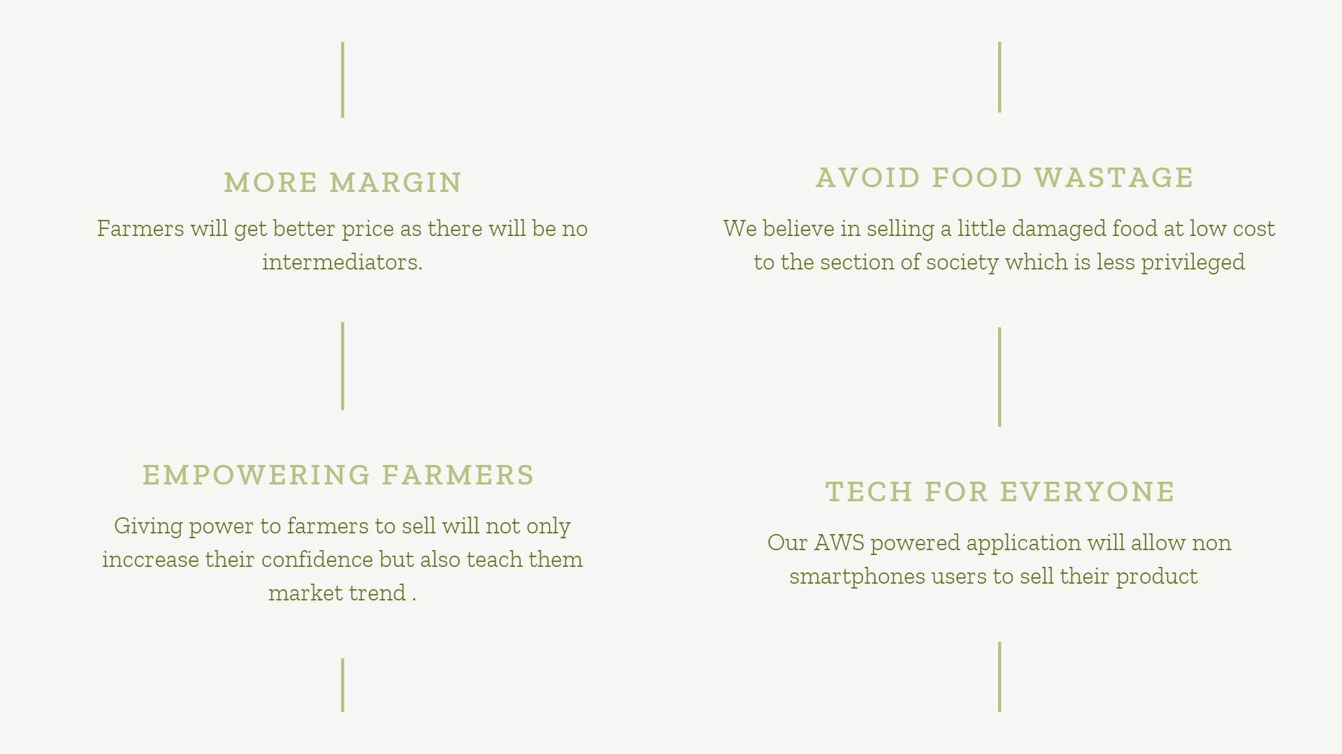

Slide 6
WEBSITE LINK
https://madhavagrawal2018.wixsite.com/website

Slide 7


